Slide 1
STOCKS DATA ANALYSIS?
Presented by: SmallData

Slide 2






Small Data
This presentation is brought to you by:
Timson T
William N
Zakaria C
Darren L
Jawad K
Jawad C

Slide 3
Table of contents
01
02
03
04
05
06
section A
Section B
A Quick Overview
Core Problem
section c
SECTion D
Method & Process
Dataset
section E
SECTion F
Business Intelligence
Our Tech Stack

Slide 4
01
Overview

Slide 5
Overview
Objective:
Conduct an in-depth comparative analysis of GPU market shares, focusing on the three leading players: AMD, NVIDIA, and Intel. We will assess stock trends, market share, and performance indicators over time.
Data Analysis & Visualization:
Python Libraries: Utilize Pandas for data manipulation and cleaning, Matplotlib and Seaborn for detailed visualizations to highlight trends, seasonality, and price patterns across each company's stock.
SQL Integration: Use PostgreSQL to manage and query large datasets efficiently, providing a foundation for complex data joins and aggregations.

Slide 6
Overview (Continued)
Business Intelligence Tools:
Visualize insights with Tableau to create interactive dashboards that track key metrics such as GPU market share, stock performance, and growth trends. Use these tools for business insights and decision-making, enabling a deeper understanding of each company’s competitive positioning.
Outcomes:
Identify and interpret key trends, KPIs and market dynamics in the GPU industry. Provide data driven insights on market share, investor trends, and potential growth areas for each company, supporting strategic investment decisions.

Slide 7
02
The Problem

Slide 8
The Problem
Tech advancement has caused significant changes in the stock of chip manufacturers
More demand for more powerful chips to process larger amounts of data.
High performance computing such as quantum computing requires more advanced chips which also increases the demand for semiconductors
The development of AI and Machine Learning has also increased the demand of GPUs
GPUs are required to do many of the calculations and model training
With that in mind, the problem arises: How have major advances in computing affected the prices of major gpu/chip manufacturers

Slide 9
03
Our SOlution

Slide 10
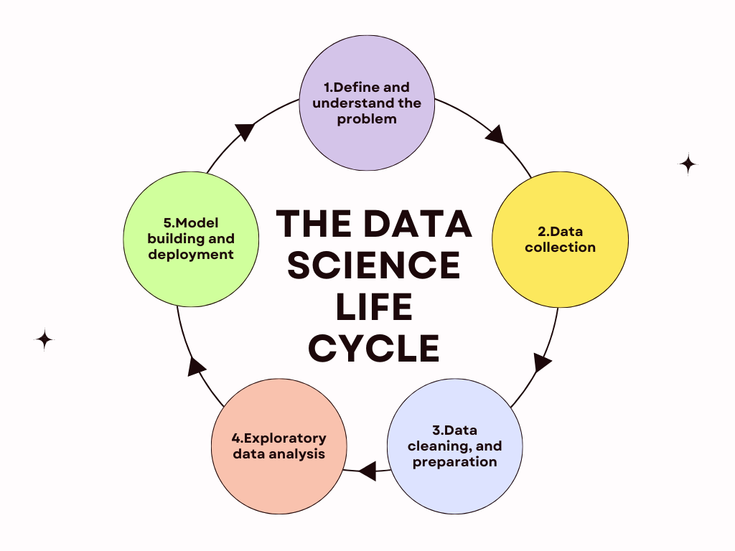
Methodology
Problem statement - How have major advances in computing affected the prices of major gpu/chip manufacturers?
Problem understanding - Which major events lead to a drastic change in stock pricing? Who has this impacted? What kind of model should we use for our predictions?
Data collection - Collect data through API’s and web scraping
Data preparation and cleaning - Using Pandas, clean the data for null/invalid/duplicates/outlier data
Data analysis - Explore the data we’ve collected using Matplotlib scatter plots and line charts illustrating the impact these major advances had on stock pricing
Model development - Create a model that can predict future stock pricing of Intel/ NVIDIA/ AMD

Slide 11
04
Datasets

Slide 12




data sources
Alpha Advantage
Bloomberg
Yahoo Finance
Finnhub
Provides access to technical indicators
Obtain news data by web scraping.
Python library support to get key information on companies.
Access aggregate data by sector

Slide 13
Data sources
Alpha advantage
Bloomberg
Yahoo finance
finnhub
Use RSI, Moving Average, Average True Range, and etc.
Capture headlines and press releases using BeautifulSoup.
Find basic metrics like P/E ratio, Dividend Yield, market cap, and etc.
Has sector metrics endpoint and aggregate data for specific sectors.

Slide 14
05
taBleau
Our Business Intelligence Choice

Slide 15
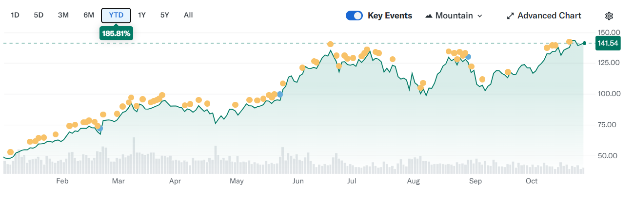
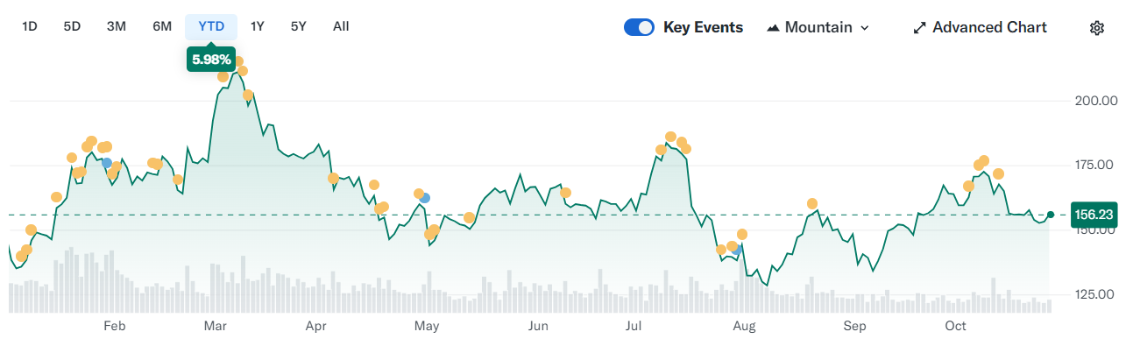
Stock price trends
performance
Stock Price Trended Over time with major events
volatility
Company Deliverables onto the trends

Slide 16
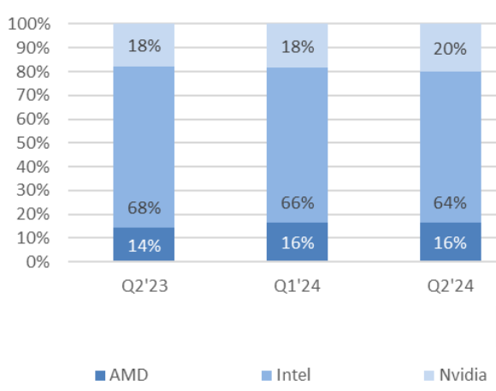
Market share Q2 2024
Total PC GPU
16%
64%
20%
AMD
Intel
NVIDIA

Slide 17
profitability
COST
trends
Total revenue
trends
net Profit
trends
Return on
investment

Slide 18
06
Tech stack

Slide 19






OUR TECH STACK
Streamlit
Python + Pandas
Python Framework for our frontend
Primary language + data manipulation/structuring and analysis with Pandas.
Yahoo finance
PostgreSQL
Library to get stock market data for data collection
Our relational DB of choice
Tableau
BI tool for visualization

Slide 20
resources
Graphs
Global GPU Shipments Increase By 1.8% In Q2 2024, NVIDIA GPU Share Increased By 2%
Yahoo Finance

Slide 21
Thanks for listening in!
Do you have any questions?

